Slide 1
HOW TO INTERACT WITH YOUR PUBLIC OFFICIALS
This Photo by Unknown Author is licensed under CC BY-SA

Slide 2
Goals from this Presentation:
How to Be Heard
Who/Where to Communicate
WV Legislature and Your Representatives
The Legislative Process
Other Organizations/Allies
C

Slide 3
Dale Carnegie
“Most of the important things in the world have been accomplished by people who have kept on trying when there seemed to be no hope at all.”
“When dealing with people, remember you are not dealing with creatures of logic, but with creatures bristling with prejudice and motivated by pride and vanity.”
“You attract more flies with honey than vinegar.”
Be POSITIVE, ENTHUSIASTIC

Slide 4
How to Be Heard:
Be Seen. Attend events where your public officials will be. “90% of it is just showing up.”
Write letters (emails, yes). Do letter-writing campaigns: -specific to your issue -personal -important to the recipient (an accomplishment of theirs, family; health, etc)
Hold Public Events/Tours/Open-Houses. INVITE your target audience
Make Phone Calls

Slide 5
How to Be Heard:
Social Media sites (provide honest, accurate information)
Volunteer for Campaigns -candidate -Issue/advocacy -charity
Fundraising (Last, but NOT least)

Slide 6
Who/Where to Communicate:
Your Public Officials. Elected, appointed; Community, County, State and Federal.
Non-Government Organizations/Advocacy Groups
Your Neighbors. If the issue affects your community, you need to tell them.
The Media: Newspapers, TV, Radio, electronic media/social
Schools – Secondary and Higher Education
Your Own Events
C

Slide 7
The West Virginia Legislature https://www.wvlegislature.gov/index.cfm
House of Delegates
304-340.3200
Senate
304.357.7800

Slide 8
Leadership – House of Delegates
Speaker: Roger Hanshaw (Clay) – Roger.Hanshaw@wvhouse.gov 304.340.3210
Majority Leader: Eric Householder (Berkeley) – Eric.Householder@wvhouse.gov 304.340.3220
Finance Chair: Vernon Criss (Wood) – Vernon.Criss@wvhouse.gov 304.340.3230
Judiciary** Chair: Moore Capito (Kanawha) – Moore.Capito@wvhouse.gov 304.340.3252
Government Org**. Chair: Chris Phillips – Chris.Phillips@wvhouse.gov 304.340.3192
House of Delegates Roster: https://www.wvlegislature.gov/House/roster.cfm 304.340.3200 (House Clerk)

Slide 9
Leadership – Senate
President: Craig Blair (Berkeley) – Craig.Blair@wvsenate.org 304-357.7801
Majority Leader: Tom Takubo (Kanawha) – Tom.Takubo@wvsenate.org 304.357.7990
Finance Chair: Eric Tarr (Putnam) – Eric.Tarr@wvsenate.gov 304.357.7901
Judiciary** Chair: Charles Trump, IV (Morgan) – Charles.Trump@wvsenate.gov 304.357.7880
Govt Org**. Chair: Jack Woodrum (Summers) – Jack.Woodrum@wvsenate.gov 304.357.7849
Senate Roster: https://www.wvlegislature.gov/Senate1/roster.cfm 304.357.7800 (Senate Clerk)

Slide 10
The West Virginia Legislature https://www.wvlegislature.gov/index.cfm
2024 Session: Wed, Jan. 10 thru Sat., March 10 (midnight
Each morning, on legislative website, check:
Bulletin Board https://www.wvlegislature.gov/Bulletin_Board/Bulletin_Board_menu.cfm
View
-House and Senate “Committee Schedules” for committee times and agendas -House “Special Calendar” and Senate “Calendar”
Tune-In: Streaming Audio and Video Links (Main Page link)
http://www.wvlegislature.gov/live.cfm

Slide 11
The West Virginia Legislature (Main Page) https://www.wvlegislature.gov/index.cfm
See RED boxes for:
Bulletin Board
Streaming Video/Audio

Slide 12
The West Virginia Legislature – Bulletin Board http://www.wvlegislature.gov/Bulletin_Board/Bulletin_Board_menu.cfm
Senate: click for
Committee Schedule
Calendar
House: click for
Committee schedule
Special Calendar

Slide 13
The West Virginia Legislature – Streaming Video-Audio http://www.wvlegislature.gov/live.cfm

Slide 14
The West Virginia Legislature https://www.wvlegislature.gov/index.cfm
Check Committee pages (under each House and Senate tabs of Main page) for :
Committee Meeting agendas
Committee Members
Other Tabs to explore for information
Bill Status (where IS that bill (in the process)??
State Law (Code, the Constitution)

Slide 15
The West Virginia Legislature https://www.wvlegislature.gov/index.cfm
Major Committees:
Finance (with subcommittees)
Judiciary (with subcommittees)
Education
Health & Human Resources
Government Organization
Minor Committees (several more than listed)
Energy
Economic Development & Tourism
Banking & Insurance

Slide 16
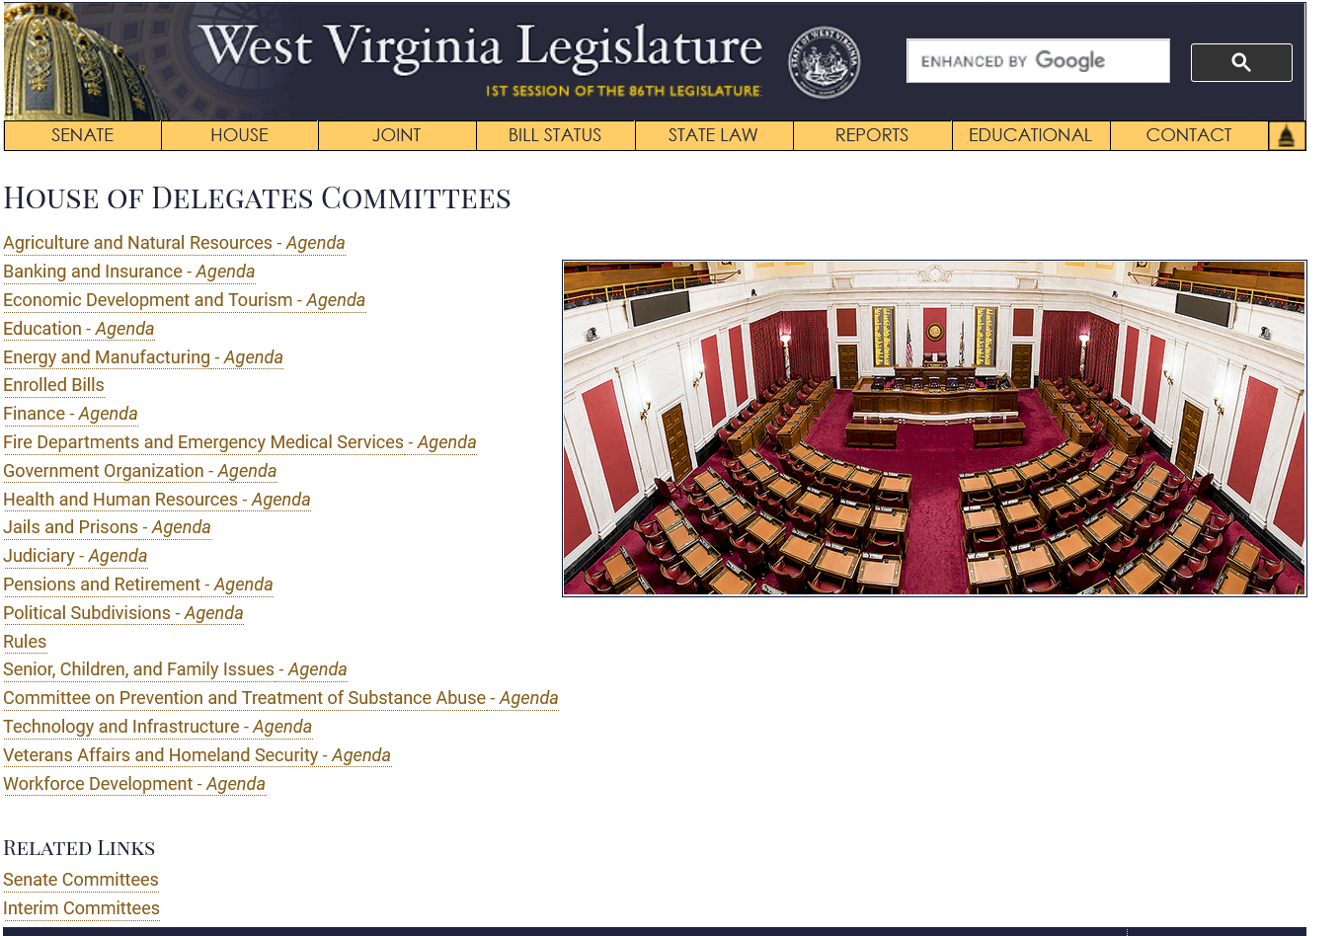
The West Virginia Legislature - Committees
http://www.wvlegislature.gov/committees/senate/main.cfm
http://www.wvlegislature.gov/committees/house/main.cfm

Slide 17
MAJOR COMMITTEE CHAIRS
VERY POWERFUL (Especially Finance and Judiciary)
They decide what gets on a committee agenda
They will only run bills that they want passed that are either Caucus Bills or Majority Party Bills
Expect the member to vote for their bills both in committee and on the floor
A vote against a majority bill is considered a slap in the face and members will be punished (ex. Removed as chair or vice chair or from a committee)

Slide 18
GET TO KNOW YOUR LEGISLATORS
Refer to them by their title (Senator/Delegate)
Meet with them! Call them! Invite them!
Tell them your concerns and the impact to your county and the state
Be the person they call for answers
“When dealing with people, remember you are not dealing with creatures of logic, but with creatures bristling with prejudice and motivated by pride and vanity.” – Dale Carnegie

Slide 19
INTRODUCED BILLS
If a bill has a low number it generally means it is a majority party bill
Examples: HB 2001; SB 1
Single Reference Bills- go to only a major committee
Double Reference Bills- go to two committees (minor/major: major/major)
Triple Reference Bills- these have little to no chance of happening
CHECK THE BILL SPONSORS**
** Work with/communicate with sponsors first

Slide 20
The West Virginia Legislature – Bill Status http://www.wvlegislature.gov/Bill_Status/bill_status.cfm

Slide 21
Party Bills
Chair will only run a minority party bill if absolutely NOT on the majority party’s main agenda
Majority Party will pass a bill handily. If it is close, members will be whipped
IF it is a good minority bill, a smart member of the minority will get a member of the majority party to be the lead sponsor
Again, only bills or amendments the majority part wants are the ones that pass
Generally around 2,000 bill are introduced and around 10% (200) pass
There are some lobbyists that represent major contributors and are very strong and influential

Slide 22
Other Agencies/Organizations/Allies
Who shares your interests or impacts your need/issue?
Non-Government Organizations (NGOs): local, state and national. Potomac Highlands; Audobon Society;
Federal Agencies that may have oversight, regulatory responsibilities -FERC (Federal Energy Regulatory Commission); DOE; FAA; EPA; DOD; Homeland Security; Fish & Wildlife

Slide 23
WV Public Service Commission
201 Brooks Street Charleston, WV 25301 Toll Free: 1-800-344-5113 FAX: 304-340-0325
Commissioners
Charlotte R. Lane
304-340-3183
Renee A. Larrick
William B. Raney “Bill”

Slide 24
Senator Shelley Moore Capito
500 Virginia St E Suite 950
Charleston, WV 25301
304-347-5372
300 Foxcroft Av Suite 202A
Martinsburg, WV 25401
304-262-9285
170 Russell Senate Office Building
Washington, DC 20510
202-224-6472

Slide 25
Senator Joe Manchin
900 Pennsylvania Ave., Ste. 629
Charleston, WV 25302
P: 304-342-5855
F: 304-343-7144
261 Aikens Center, Ste. 305
Martinsburg, WV 25404
P: 304-264-4626
F: 304-262-3039
306 Hart Senate Office Building
Washington D.C. 20510
P: 202-224-3954
F: 202-228-0002

Slide 26
Congressman Alex Mooney
120 N George St Second Floor
Charles Town, WV 25414
P: 304-264-8810
2228 Rayburn House Office Building
Washington, DC 20515
P: 202-225-2711
F: 202-225-7856

Slide 27
Jonathan A. Adler Executive Director, WVACo 304-346-0591 304-549-0504 Jonathan@wvaco.org
Lucy

